Slide 1
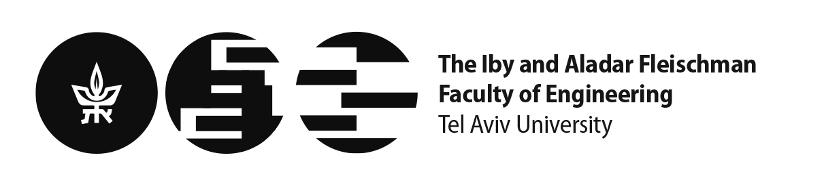
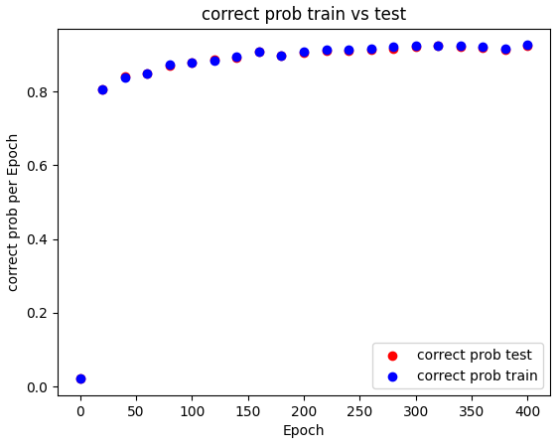
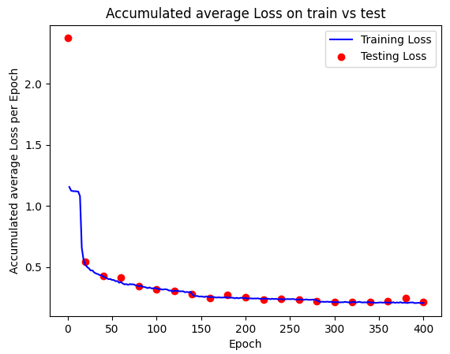
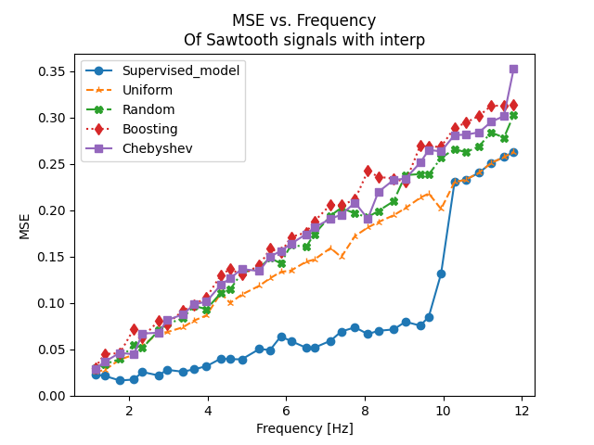
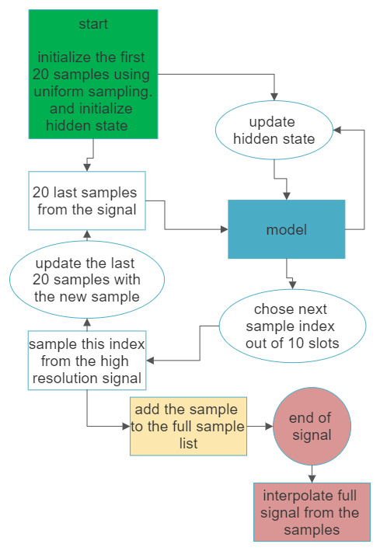
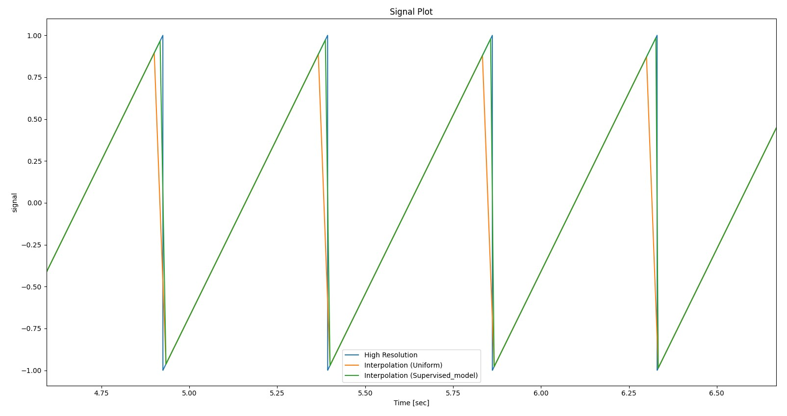
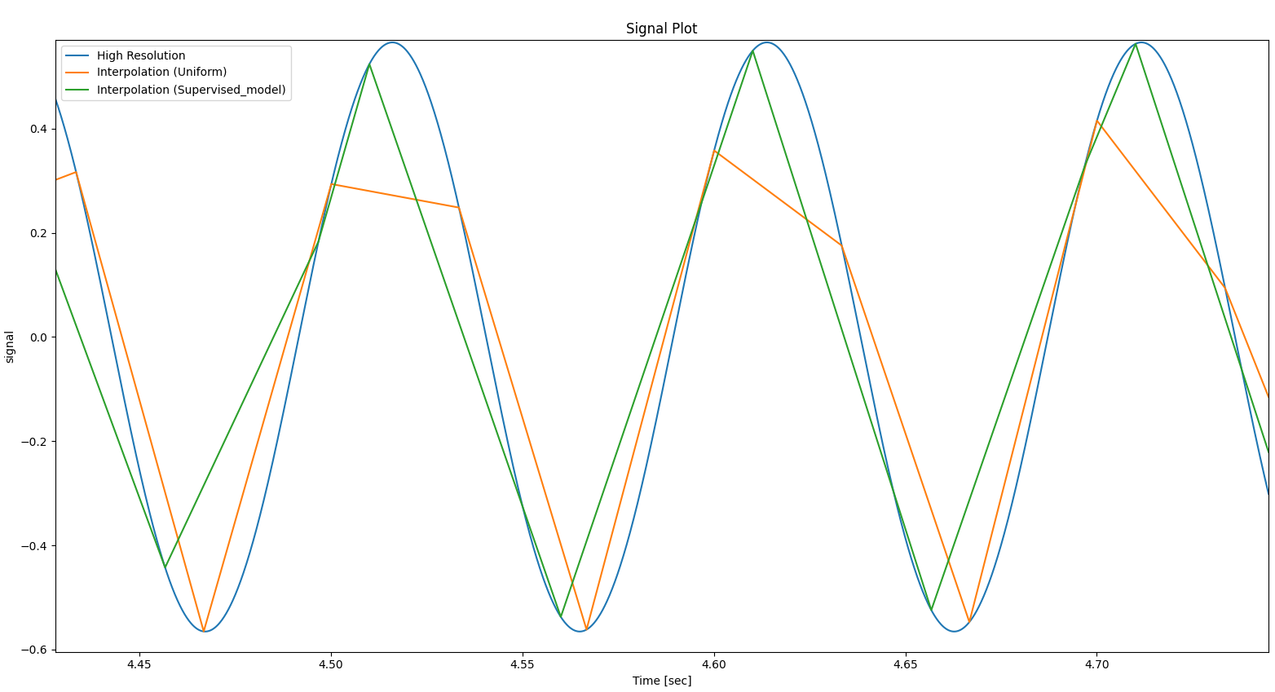
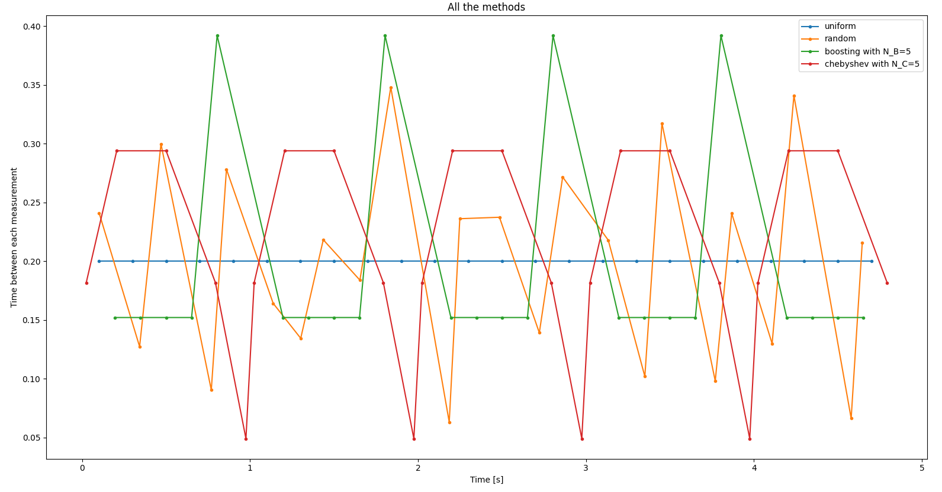
None Uniform Sampling Super Resolution
Project Number: 22-1-1-2423
Names: Tomer Rajwan , Etay Ashkenazi
Advisor: Khen Cohen
Introduction Our project explores the possibility of improving reconstruction results through non-uniform sampling of a given signal. We aim to compare the performance of linear and CubicSpline interpolation on signals with varying frequencies, both above and below the Nyquist conditions for uniform sampling. By incorporating machine learning algorithms, we aim to identify where does ML yield the most effective results in this context. Motivation/Objectives Our project could have a range of potential applications, The ability to reconstruct signals from fewer samples could be particularly useful in applications where data acquisition is expensive or time-consuming, or where data storage is limited, such as MRI, where each sample is expensive and can be harmful. Additionally, non-uniform sampling may enable the detection of features in signals that would be missed in uniform sampling, leading to improved resolution in various applications, such as audio and video processing. by taking the samples in regions of interest, we can achieve better reconstruction results. Our objective is for the model to at least preform better then the best sampling method by 5% of the MSE. The problem We will take signals and divide them into frames in a rate of 30 fps, where each frame is divided into 10 slots. The challenge is to determine which slots should be sampled in order to achieve the most accurate reconstruction of the signal. Machine learning algorithms will be used to determine the optimal sampling strategy for each frame, based on the samples up to this point. Approaches to the problem First is the naive approach : we will sample at a determined points, we will compare different sampling policies: the time difference between samples | The Chebyshev sampling method (red) is sampling at points which are the roots of an order N Chebyshev polynomial. The Boosting sampling method (green) is sampling that tries to takes sets of N samples and place the samples closer together. Second is ML approach, we will use different supervised ML networks to try and learn what are the optimal slots to chose. the training will be done using pre-calculated right answers calculated with future knowledge of the signal. Methods/Implementation Our project aims to assess when ML architectures should be used for signal reconstruction. We will use LSTM type architectures to compare where and in what cases does ML preforms better then other sampling methods. We compared the performance on different signals (sin ,tringle , complex, digital) We also add features calculated only from the sample to the model such as FFT and the derivative of the last points to see if this data will help the model. Sampling using model diagram | Results Training results: the first is correct precent, the second is losses Graph of MSE vs. freq. of sawtooth wave, with different sampling regime with linear interpolation (our model is blue). we’ve obtained an improvement of 50% with our model over uniform sample (in <10 frequencies) : Example of sampling sin signal of 11Hz. (green is liner interpolation of samples from our model, and orange is uniform samples): Conclusions We have observed improved performance of our model compared to other sampling. These findings suggest potential real-life applications for our approach. Further research is needed to fully optimize the effectiveness of this approach across a broader range of signals and scenarios.

